Slide 1
How 3D is captured
DAY 06 OF 16 · 3D & 6DOF STREAMING
LiDAR, photogrammetry and depth cameras, and the one formula that links a pixel to a point in space.
Sensors
Pinhole camera
Intrinsics & extrinsics
RGB-D → points
Fusing views
Book: Ch. 1, 3, 10 · Code: day06_capture_camera_model/
Notes:
Today covers data acquisition (book Chapter 1, workflow step 1, and Chapter 3, 3D reconstruction methods) and the pinhole camera model used in the book’s Chapter 10 monocular depth project. The pinhole model is also the basis of every renderer, so it returns on Day 11.

Slide 2
Three ways to capture the real world in 3D
BOOK CH. 1 & 3
LiDAR
Photogrammetry
Depth cameras
Measures distance with laser pulses. Accurate, works in the dark; terrestrial, mobile and airborne.
Many overlapping photos → Structure from Motion → dense points and meshes. Cheap; struggles with glass and shiny metal.
Structured light or time of flight give RGB-D frames in real time (Kinect, RealSense, phone LiDAR).
01
02
03
Day 06 · Capture & camera model
2
Notes:
The book separates sensor-based (real-world) reconstruction from creative reconstruction. Give examples: airborne LiDAR for country-scale maps, terrestrial laser scanners for buildings, phone LiDAR for rooms. Photogrammetry with SfM finds the same points in many photos and triangulates them; the book notes it struggles with transparency, reflections and fine details like hair, which is one reason NeRF and Gaussian splatting appeared (Day 10). Depth cameras are what volumetric video studios and AR headsets use. Mini-project P1 asks students to capture something themselves.

Slide 3
From a 3D point to a pixel
THE PINHOLE CAMERA
u = fx · X / Z + cx v = fy · Y / Z + cy
X, Y, Z
fx, fy
cx, cy
Point in CAMERA coordinates (after applying the pose).
Focal length in pixels: how much the image is zoomed.
Principal point: usually the image centre.
Day 06 · Capture & camera model
3
Notes:
Draw a pinhole camera on the board: light travels in straight lines through one point. The division by Z is perspective: distant things look smaller. The lab does this by hand for the house’s roof ridge and prints pixel (320, 131.6). The four numbers fx, fy, cx, cy form the intrinsic matrix K. The book sets them in Open3D with PinholeCameraIntrinsic.set_intrinsics(width, height, fx, fy, cx, cy). Ask: if you double fx, what happens to the image? Everything looks twice as big: a zoom.

Slide 4
Intrinsics vs extrinsics
BOOK CH. 10 NOTE
Intrinsics K
Extrinsics [R | t]
Inside the camera: focal length, principal point, lens distortion. Found by calibration with a checkerboard.
Where the camera is and where it looks: the 6DoF pose from Day 2.
01
02
Day 06 · Capture & camera model
4
Notes:
The book’s note on intrinsic and extrinsic parameters: intrinsics describe how the camera projects 3D onto the image plane, extrinsics define the camera’s pose in the world. To get accurate intrinsics, photograph a checkerboard from many angles and use OpenCV’s calibration. Link to Day 2: the extrinsic is literally a 4x4 pose matrix. The full chain is pixel = K · [R | t] · world point.

Slide 5
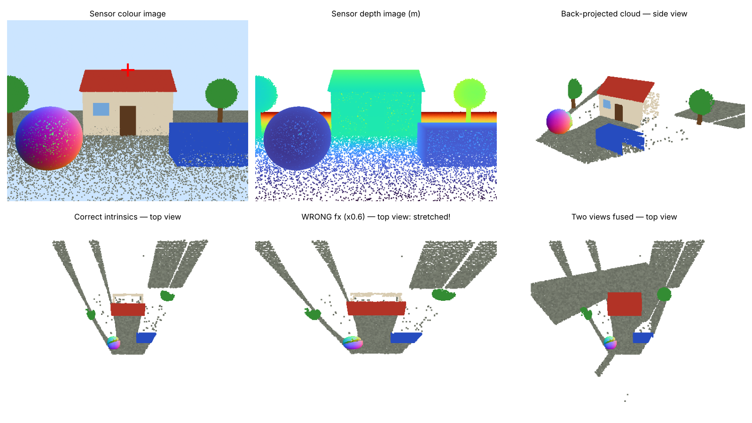
Depth image → point cloud, and why K must be right
LAB PREVIEW
With the right fx the house is 6.5 m wide; with fx × 0.6 it becomes 10.8 m. Two views fill the hidden side.
Day 06 · Capture & camera model
5
Notes:
Walk through the six panels: the simulated sensor colour image (red cross = the hand-projected point), its depth image, the back-projected cloud, then top views. Back-projection inverts the pinhole formula: X = (u − cx) · Z / fx. With a wrong focal length every point lands in the wrong place; the script measures the house width 6.47 m (true walls 6.0 m, roof 6.4 m) versus 10.78 m with fx 40 percent too small. Notice the wedge shape and the shadows behind trees: one view only sees what is in front of it. The last panel fuses a second view and fills the back of the house. That is the core idea of scanning and of photogrammetry.

Slide 6
Build a point cloud from a (simulated) depth camera
HANDS-ON LAB · COPY, RUN, LOOK
RUN IT
cd day06_capture_camera_model
python pinhole_and_rgbd.py
→ Check the hand-computed pixel (u, v).
→ Compare house widths: right vs wrong fx.
→ Open outputs/fused_two_views.ply.
Day 06 · Capture & camera model
6
Notes:
Run, then README exercises: change the field of view, add realistic depth noise, add a third view from behind. Announce mini-project P1 (scan to cloud) which starts now and is due at Day 8. Students can use a phone photogrammetry app or a public RGB-D frame. 30 minutes.

Slide 7
Three things to remember
1
LiDAR, photogrammetry and depth cameras all end as points with positions.
2
Pixel = K · [R | t] · point. Intrinsics inside, extrinsics = the 6DoF pose.
3
One view is 2.5D; fusing several views gives full 3D.
BEFORE NEXT SESSION
Lab L3 and mini-project P1 (scan to cloud). Next: organising millions of points.
Day 06 · Capture & camera model
7
Notes:
Recap. P1 is due at Day 8. Preview Day 7: k-d trees and octrees, the data structures that make large clouds searchable and streamable.

